Slide 1
ZHH Group Holding LLC
Building a Legacy of Trust and Growth
Emirati Strength, Global Horizons

Slide 2
Homepage – Hero Section
ZHH Group Holding is a sovereign-style Emirati investor managing a diversified portfolio.
AED 100M+ Assets Under Management
20+ Years of Growth
10+ Countries of Operations

Slide 3
Homepage – Key Highlights
Our Global Footprint in Numbers:
AED 100M+ AUM
70+ Completed Projects
12B+ AED Total Project Value
300+ Direct Employees / 1,200+ Indirect
1.2 Tons Gold Traded
180+ Trade Contracts Executed
24 Major Construction Projects
Presence in 10+ Countries

Slide 4
Homepage - Private Equity – Overview
Private Equity:
Strategic investments in UAE and global markets.
Focus Areas:
Real Estate
Gold Mining
Global Trading

Slide 5
Homepage - Private Equity – Strategy
Our Investment Strategy:
Target high-growth sectors
Governance & transparency
Regional expansion
Responsible, long-term value creation

Slide 6
Homepage - Private Equity – UAE Investments
UAE Investments:
Premium residential & commercial
Dubai gold ecosystem

Slide 7
Main Menu
WHO WE ARE
ABOUT ZHH GROUP HOLDING (separate page)
A JOURNEY OF EXCELLENCE (ID)
BOARD OF DIRECTORS (ID)
OUR STRUCTURE (ID)
OUR PORTFOLIO
ZHH Construction LLC (separate page)
ZHH General Trading LLC (separate page)
ZHH Real Estate LLC (separate page)
Jewelust Jewelry & Gold Bullion Trading LLC (separate page)
OUR IMPACT
INVESTORS

Slide 8
Who We Are - About ZHH Group Holding
ZHH Group Holding is a diversified Emirati conglomerate investing in construction, real estate, global trading, and precious metals.
A legacy built on governance, innovation, and responsible growth.
CEO MESSAGE
VISION
MISSION
CORE VALUES
OUR EMIRATI IDENTITY
GLOBAL PRESENCE MAP

Slide 9
Who We Are - About ZHH Group Holding
Chairman's Message Mohamed Al Hammadi Founder, Owner & Chairman – ZHH Group Holding & Subsidiaries ZHH Group Holding stands as a proud symbol of Emirati ambition and excellence. Founded in the United Arab Emirates, our Group was built on a vision to contribute to the nation’s economic growth through innovation, integrity, and world-class performance across every sector we operate in. From construction and real estate to global trading and precious metals, each of our subsidiaries — including Jewelust, our flagship in gold bullion and jewelry — reflects our commitment to sustainable development and long-term value creation. We are not only expanding our presence across regions but also reinforcing the UAE’s position as a hub for reliability, and opportunity. Our mission is to grow with purpose — to build, trade, and invest responsibly while maintaining the trust of our partners, the strength of our nation, and the legacy of Emirati leadership for generations to come. Our Divisions ZHH Construction As one of the leading entities in the region’s construction sector, ZHH Construction specializes in delivering high-quality infrastructure, residential, and commercial projects. We build with precision and passion, shaping skylines and creating lasting landmarks. ZHH Real Estate Our real estate division focuses on creating long-term value through strategic property development and diversified investment portfolios. We identify opportunities that promote sustainable growth and strengthen community living. ZHH General Trading ZHH General Trading serves as a global bridge for sourcing and supplying premium raw materials and products from around the world — including rice, flour, spices, coffee, frozen meat, poultry, cosmetics, toys, groceries, oil, sugar, and gold. With trusted networks in the USA, Belgium, Australia, India, Pakistan, China, Spain, Thailand, and beyond, we ensure quality and reliability in every trade. Jewelust Established in Dubai, Jewelust is the crown jewel of our group — a brand that celebrates the art of fine jewelry and gold bullion trading. With branches across Turkey, Uganda, Mali, and Congo, Jewelust is recognized for its craftsmanship, heritage designs, and secure international gold trading operations. Our Commitment At ZHH Group Holding, we are more than a business; we are a family of innovators, engineers, traders, and visionaries united by a common goal — to build a better future. Our executive management team embodies our core values of leadership, integrity, and excellence in every decision they make. We look ahead with optimism, confident that through dedication and collaboration, ZHH Group will continue to set new standards of success across industries and borders. Mohamed Al Hammadi Chairman & CEO ZHH Group Holding

Slide 10
Who We Are - About ZHH Group Holding
Our Vision To be a leading Emirate holding group that delivers value-driven excellence in every sector we operate, contributing to economic prosperity and global trade connectivity, while strengthening the UAE's global economic presence. Our Mission We drive success through strategic investments, operational excellence, and innovative solutions across construction, real estate, global trade, and precious metals — while maintaining the highest ethical, compliance, and governance standards.
We empower our subsidiaries to lead in their markets by providing strong corporate governance, advanced technologies, and collaborative leadership — expanding our footprint, strengthening partnerships, and maximizing long-term stakeholder value. Core Values Integrity – Transparent, ethical, and accountable. Excellence – Setting new standards in quality and performance. National Pride – Advancing the UAE’s vision for prosperity. Sustainability – Building responsibly for future generations. Partnership – Creating trusted, mutually beneficial collaborations.
Our Emirati Identity Founded in the United Arab Emirates, ZHH Group Holding carries the values of the nation — vision, integrity, and innovation. Every project and partnership contributes to the UAE’s economic strength and global reputation for excellence. Global Presence
A growing Emirati presence supporting trade and strategic development.
Africa – Licensed Sourcing (Uganda, Kenya, Mali, Burkina Faso, Guinea, Sierra Leone, Congo)
Turkey – Refining & Manufacturing
UAE – Global Trade Hub (Dubai)
Asia & Europe, South America, Africa – Investor & Retail Markets

Slide 11
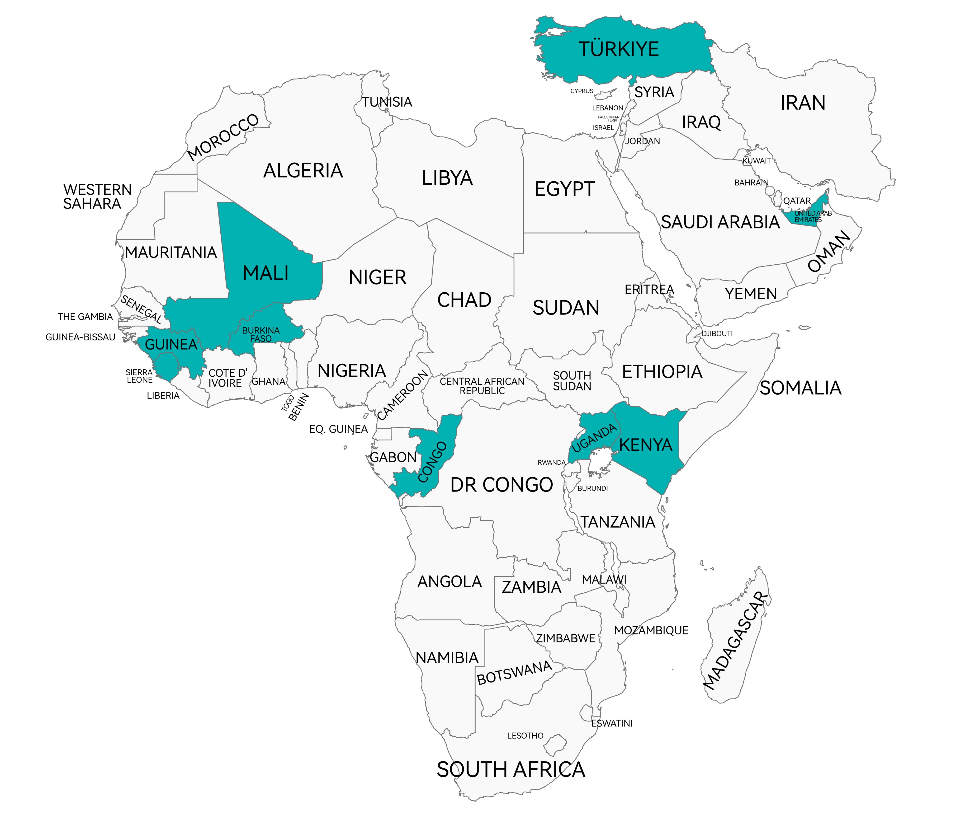
MAP
UAE
Abu Dhabi (Main Offices):
ZHH Group Holding LLC
ZHH Construction LLC
ZHH General Trading LLC
ZHH Real Estates
Dubai (Main Office & Showroom):
Jewelust Jewelry & Gold Bullion Trading LLC
UGANDA
ZHH General Trading
Jewelust Jewelry
KENYA
ZHH General Trading
Jewelust Jewelry
MALI
ZHH General Trading
Jewelust Jewelry
CONGO
ZHH General Trading
Jewelust Jewelry
GUINEA
ZHH General Trading
BURKINA FASO
ZHH General Trading
SIERRA LEONE
ZHH General Trading
TURKEY
Jewelust Jewelry
TANZANIA
Jewelust Jewelry
ZAMBIA
Jewelust Jewelry
ZIMBABWE
Jewelust Jewelry

Slide 12
Who We Are - A Journey of Excellence
2003 — Foundations in Abu Dhabi Launched as a construction & building maintenance company supporting the UAE’s growth and infrastructure ambitions. 2007 — Expansion into Hospitality Diversified operations with the launch of F&B ventures, demonstrating agility and entrepreneurial growth. 2010 — IT & Technology Services Entered the technology sector, providing equipment, maintenance, and digital services to support modernization needs. 2020 — ZHH General Trading Established — Abu Dhabi Began global sourcing and commodities trading, supplying diverse products to UAE and international markets. 2021 — Strategic Diversification & Real Estate Division Launched ZHH Real Estate, strengthening investments across key UAE cities. Formally established ZHH Group Holding, unifying operations under a vision for long-term growth.
2022 — International Expansion — Africa
Opened trading branches across Uganda, Mali, Guinea, Kenya, Burkina Faso, and Sierra Leone — building secure logistics and sourcing networks.
2024 — Group Consolidation & Corporate Governance Excellence
Centralized construction, real estate, and trading under one Holding structure; ensured compliance, governance, and brand unity.
2025 — Launch of Jewelust — Dubai
Established Jewelust as the Group’s flagship in ethical gold sourcing, jewelry, and global bullion trading — reinforcing Dubai’s role as the world’s premier gold hub.
Today
ZHH Group stands as a proud Emirati-built conglomerate with expanding international footprint across construction, real estate, global trade, and precious metals — driven by integrity, innovation, and a commitment to shaping a prosperous future for the UAE and beyond.

Slide 13
Who We Are - Board of Directors
Najeeb PK
Chief Financial Officer (CFO)
“Strong financial management is the backbone of our success. At ZHH Group, we focus on smart investments, operational efficiency, and fiscal discipline — ensuring that every venture contributes to our long-term growth and global expansion.”
Shamma Al Amri
Chief Marketing Officer (CMO)
“ZHH’s strength lies in its diversity and global presence. Through strategic marketing and brand storytelling, we aim to share our vision with the world — highlighting our values, quality, and commitment to excellence in every market we touch.”
Mohamed Rafeeq CEO – ZHH General Trading “ZHH General Trading is an Emirati company that reflects the spirit of Dubai — dynamic, global, and forward-looking. We are committed to supporting the UAE’s economic diversification by driving trade excellence across multiple sectors, connecting trusted partners, and promoting ethical, transparent business practices. With innovation and integrity at our core, we aim to be one of the UAE’s leading trading houses recognized for reliability and value creation.”
Ahmed Ali
CEO – ZHH Real Estates
"At ZHH Investment & Real Estate, we believe in creating lasting value through visionary projects that shape the urban landscape of the UAE. As an Emirati company, we are deeply committed to supporting the national economy by investing in sustainable developments that combine architectural excellence, community well-being, and financial growth. Our goal is to be a trusted name in real estate investment, redefining quality and reliability across the UAE and beyond."

Slide 14
Who We Are - Board of Directors
Shadi
CEO – ZHH Construction
"ZHH Construction represents the strength and ambition of an Emirati company committed to building the future of the UAE. Our vision is to become one of the nation’s leading construction firms — delivering sustainable, world-class projects that enhance infrastructure, empower communities, and contribute to the UAE’s economic growth. Guided by precision, innovation, and integrity, we build with pride and purpose for generations to come.”
Mohamed Al Hammadi Founder & CEO – Jewelust “Gold is more than a commodity — it is security, strength, and enduring value. From Africa’s licensed gold sources to Dubai’s global bullion hub, Jewelust is building a trusted bridge between origin and investment. With transparency, integrity, and innovation at our core, we empower investors, strengthen markets, and deliver wealth that lasts for generations.”
Closing Note for the Management Page
“Together, the leadership team of ZHH Group Holding represents a shared vision — to build trust, empower innovation, and connect markets across continents. Guided by strong values and a commitment to excellence, we continue to shape the future with determination and purpose.”

Slide 15
Who We Are - Our Structure
Our Subsidiaries 🏗️ ZHH Construction Building with Integrity & Precision An Emirati company delivering sustainable, world-class infrastructure that supports the UAE’s growth and modernization. Goal: To be one of the nation’s leading construction firms known for reliability and innovation. 🏢 ZHH Real Estates Creating Value through Vision Focused on premium developments and sustainable real-estate investments that enrich communities and strengthen the national economy. Goal: To redefine quality living and investment opportunities in the UAE.
🌐 ZHH General Trading Connecting Markets, Empowering Trade A dynamic Emirati trading house bridging regional and global markets with transparency and compliance. Goal: To support the UAE’s diversification strategy and become a trusted global trade partner.
💎 Jewelust – Gold & Bullion Trading Where Wealth Becomes Legacy The Group’s flagship in gold and bullion, representing Dubai’s leadership in global precious-metal trade. Responsible sourcing from Africa, refining in Turkey, and trading through Dubai’s secure market channels. Goal: To be the UAE’s most trusted name in ethical, transparent, and investment-grade gold trading.
✨ Closing Statement ZHH Group Holding continues to expand its legacy as an Emirati-driven enterprise that builds, trades, and invests with integrity and innovation — strengthening the UAE’s role as a global hub for excellence.

Slide 16
Organization Chart

Slide 17
Our Portfolio
Our Portfolio:
ZHH Construction LLC
ZHH General Trading LLC
ZHH Real Estate LLC
Jewelust Jewelry & Gold Bullion Trading LLC

Slide 18
ZHH Contruction
Delivering Excellence, Building the Nation
Overview ZHH Construction is the engineering and contracting arm of the Group, delivering high-quality, sustainable construction solutions that contribute to the UAE’s national development. The company focuses on precision and safety across residential, commercial, and infrastructure projects. Establishment Founded in 2003 as the Group’s first operating entity, ZHH Construction began as a contracting and building maintenance business in Abu Dhabi, supporting national infrastructure growth. It continues to expand its footprint as a trusted contractor in the UAE. Core Activities EPC & general contracting works Construction of residential, commercial, and industrial properties Infrastructure & utility projects Green construction and smart-system implementation Building maintenance and facility enhancements
Completed Projects & Achievements
24+ completed projects across the UAE (2020–2024) with 100% on-time & on-budget delivery
Industrial housing & logistics facilities in Dubai
Al Ain commercial & residential development
Municipal infrastructure upgrades across Northern Emirates
Smart-city pilot utilities implementation in Abu Dhabi
Zero-incident safety record on major projects
Shadi Mohamed
CEO – ZHH Construction
"ZHH Construction represents the strength and ambition of an Emirati company committed to building the future of the UAE. Our vision is to become one of the nation’s leading construction firms — delivering sustainable, world-class projects that enhance infrastructure, empower communities, and contribute to the UAE’s economic growth. Guided by precision, innovation, and integrity, we build with pride and purpose for generations to come.”

Slide 19
ZHH General Trading LLC
Connecting Markets, Empowering Trade
Through its trading division, ZHH Group has built a solid reputation for reliability and transparency across several commodity categories.
Overview ZHH General Trading is a proud Emirati company headquartered in Abu Dhabi, founded to support the UAE’s vision for global trade leadership and economic diversification. Built on principles of trust, transparency, and strategic market connectivity, the company plays a pivotal role in bridging international supply chains and facilitating secure, compliant trade flows across regions. Establishment Established in 2020 to meet the growing demand for high-quality sourcing and supply channels across multiple sectors, ZHH General Trading was created with a mission to strengthen import & export capabilities and enhance the UAE’s role as a global logistics and commercial gateway. From its inception, the company has focused on disciplined procurement practices, ethical trade frameworks, and strong vendor partnerships — ensuring sustainable value creation for clients and stakeholders.
Core Activities ZHH General Trading specializes in multi-sector commodity supply and export solutions, including:
Agricultural commodities: rice, flour, sugar, spices, and coffee; consumer goods
Construction and industrial materials
Chemical & petrochemical materials
Metals, scrap & raw substances
Machinery, equipment, and spare parts
Secure & compliant gold trade channels
The company provides full supply chain support including sourcing, logistics, export documentation, quality assurance, and trade compliance.

Slide 20
Regional Presence & Branches
* United Arab Emirates – Headquarters, Abu Dhabi Central hub for coordinating procurement, import logistics, compliance and global export functions. * Africa – Sourcing Offices / Branches Uganda (East Africa) Kenya (East Africa) Mali (West Africa) Burkina Faso (West Africa) Guinea (West Africa) Sierra Leone (West Africa) Congo (Central Africa)
These offices focus on direct sourcing of agricultural products, raw materials, metals and other key commodities for import into the UAE and global markets.
Achievements & Milestones ZHH General Trading continues to grow its presence and reputation through: Successful execution of over 180+ trade contracts across GCC, Africa, Europe, South Amercia and Asia Establishing compliance-driven sourcing channels from Africa to UAE Supporting national food security & industrial supply initiatives Achieving 100% transparency & documentation compliance in cross-border trade Building exclusive vendor and refinery partnerships Contributing to group-wide expansion into precious metals trade operations Through disciplined governance, market expertise, and responsible global sourcing, ZHH General Trading has positioned itself as a trusted Emirati trading house, supporting both national economic priorities and global market integration.
Mohamed Rafeeq CEO – ZHH General Trading “ZHH General Trading is an Emirati company that reflects the spirit of Dubai — dynamic, global, and forward-looking. We are committed to supporting the UAE’s economic diversification by driving trade excellence across multiple sectors, connecting trusted partners, and promoting ethical, transparent business practices. With innovation and integrity at our core, we aim to be one of the UAE’s leading trading houses recognized for reliability and value creation.”

Slide 21
ZHH Real Estates
Creating Value Through Vision
Overview ZHH Real Estates is the property investment and development arm of ZHH Group Holding, focused on creating enduring value through visionary real-estate projects across the UAE. Guided by strong Emirati leadership, the company develops premium residential, commercial, and mixed-use assets designed to enrich communities and support national urban growth. Establishment Established in 2021, ZHH Real Estate was founded to diversify the Group’s portfolio and capitalize on strategic real-estate opportunities within the UAE’s growing property sector. It plays a key role in building sustainable projects that reflect architectural excellence and modern living standards. Core Activities Development of residential and commercial properties Investment in premium land banks and long-term real-estate assets Execution of mixed-use and community-driven projects Sustainable development focused on energy efficiency and quality of life Leasing & property management of developed assets

Slide 22
ZHH Real Estates
Achievements ZHH Tower — Business Bay, Dubai 24-storey mixed-use tower reflecting modern Emirati architecture Al Qurm Villas — Abu Dhabi Luxury villas with smart systems & landscaped community Sharjah Central Residences Residential mid-rise targeting affordable luxury segment Strategic Land Development — Ras Al Khaimah Acquisition & early infrastructure for industrial & logistics zoning All completed projects successfully sold or leased, ensuring strong investor returns
Ahmed Ali
CEO – ZHH Real Estate
"At ZHH Real Estate, we believe in creating lasting value through visionary projects that shape the urban landscape of the UAE. As an Emirati company, we are deeply committed to supporting the national economy by investing in sustainable developments that combine architectural excellence, community well-being, and financial growth. Our goal is to be a trusted name in real estate investment, redefining quality and reliability across the UAE and beyond."

Slide 23
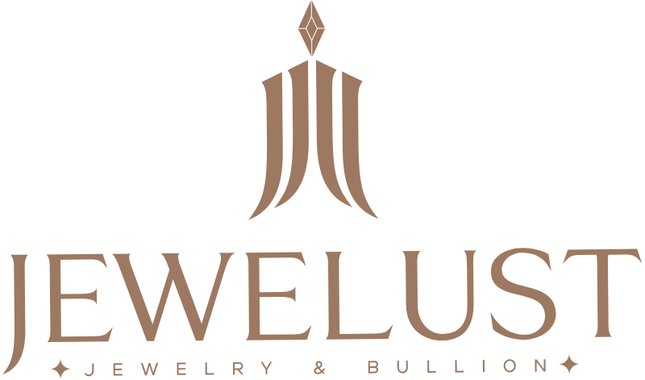
Jewelust Jewelry & Gold Bullion Trading LLC
Where Wealth Becomes Legacy
Jewelust, the Group’s flagship in precious metals, has achieved remarkable milestones in sourcing, refining, and trading investment-grade gold under strict international standards.
Overview Jewelust is the flagship precious-metals and jewelry brand of ZHH Group Holding, positioned at the heart of Dubai’s global bullion hub. Built on integrity and transparency, Jewelust connects responsible mining sources with world-class refining and global investment markets. Establishment Established in 2025 in Dubai, Jewelust was created to elevate the Group’s presence in ethical gold sourcing, bullion trading, and jewelry, leveraging Dubai’s position as the world’s premier gold hub.
Core Activities Wholesale and bullion trading Investment-grade gold sourcing from licensed African partners Refining partnerships in UAE and Turkey for hallmarking & purity assurance Retail & wholesale jewelry business Secure logistics, insurance, and compliance management

Slide 24
Jewelust Jewelry & Gold Bullion Trading LLC
Branches & Global Presence
Jewelust operates a strategic international network to support ethical sourcing, refining, and distribution:
UAE
Dubai – Head Office & Gold Souk Showroom
Retail, wholesale bullion trading, investor relations, logistics coordination
Africa – Licensed Sourcing Offices
Uganda — Structured procurement & ethical sourcing operations
Mali — Local sourcing partnerships & compliance oversight
Congo — Direct mine-to-refinery coordination & supply chain control
Kenya - Regional consolidation hub for multi-country gold flows
Turkey
Istanbul — Refining partnerships, hallmarking, and jewelry manufacturing
This network enables Jewelust to maintain fully controlled and transparent supply chains from mining origin to investment markets, reinforcing reliability, trust, and governance across all operations.
Achievements & Milestones 1.2+ tons of gold traded (2023–2024) via regulated UAE channels Ethical supply chain from Uganda, Mali, Congo Jewelust flagship store launched in Dubai Gold Souk Refineries collaborations in UAE and Turkey for certified purity and hallmarking Secure logistics & risk-management system for gold and valuables Growing B2B and private investor network across the UAE and global markets
Reinforce Dubai’s reputation as the world’s heart of gold trading
Mohamed Al Hammadi Founder & CEO – Jewelust “Gold is more than a commodity — it is security, strength, and enduring value. From Africa’s licensed gold sources to Dubai’s global bullion hub, Jewelust is building a trusted bridge between origin and investment. With transparency, integrity, and innovation at our core, we empower investors, strengthen markets, and deliver wealth that lasts for generations.”

Slide 25
Jewelust Jewelry & Gold Bullion Trading LLC
Abdallah Khafash
COO – Jewelust, Dubai
"Dubai is the heart of global gold trade — a trusted hub for investment and enduring wealth. At Jewelust Dubai, we honor that legacy with excellence, innovation, and transparency, delivering secure and compliant bullion solutions that elevate trust and protect value for generations"
Ismail Dabbur
COO – Jewelust, Uganda
“Uganda’s growing gold sector offers immense potential. Our focus is on ethical sourcing, fair trade, and strong community engagement, ensuring Jewelust remains a trusted partner in Africa’s gold market.”
Cheick Oumar
COO – Jewelust Mali
“Mali’s rich heritage in gold inspires our operations. We strive to combine local expertise with global standards — promoting responsible mining, fair trade, and sustainable development in every partnership.”
Pius Wampamba COO – Jewelust, Congo “In Congo, we see opportunity and responsibility. At Jewelust Congo, we build sustainable partnerships and ensure strict compliance — enabling secure pathways from mine to market, and driving growth for communities and investors alike.”
Mustafa Dogan
COO – Jewelust, Turkey
“From ancient artistry to modern design, Turkey’s jewelry tradition is world-renowned. At Jewelust Turkey, we merge heritage with innovation — producing and trading gold jewelry that reflects beauty, culture, and craftsmanship.”

Slide 26
Our Impact – Overview
Our Impact:
We create economic, social, and environmental value.
Pillars:
Environment
Community
Responsible Gold

Slide 27
Our Impact – Environment
Responsible Sourcing:
Ethical gold sourcing from licensed African mines
ESG-aligned refinery partnerships
Energy-efficient construction practices

Slide 28
Our Impact – Community
Community & Employment:
300+ Direct Jobs
1,200+ Indirect Jobs
Skill development
Fair trade partnerships

Slide 29
Investors
For Investors:
Diversified portfolio across construction, real estate, gold, and trading.
Strong governance & sustainable returns.
Investment Highlights:
AED 100M + AUM
12B+ AED Project Value
70+ Completed Projects
1.2 Tons Gold Traded
3 Licensed Gold Mines Under Active Development
Capital Investment Deployed into Mining Operations
Zero Compliance Violations
Strategic Gold Mining Investments
ZHH Group Holding has expanded its upstream capabilities through the acquisition and development of three licensed gold mines across Africa, reinforcing long-term supply security and responsible production.
Key Highlights:
Ownership and active development of 3 legally licensed mining sites
Continuous investment into infrastructure, technology, and extraction capacity
Fully traceable supply chain integrated with Jewelust’s responsible sourcing framework
Environmental and community safeguards aligned with international mining standards
Strengthening Dubai’s position as the global hub for ethical and regulated gold trade
Impact:
Ensures long-term production capacity for Jewelust
Enhances investor confidence through tangible, asset-backed growth
Contributes to economic development in mining communities
Supports the UAE’s vision for global commodity leadership

